Slide 1



EXPEDIA INC.
Suggesting Amazon
EBS Volume Type

Slide 2
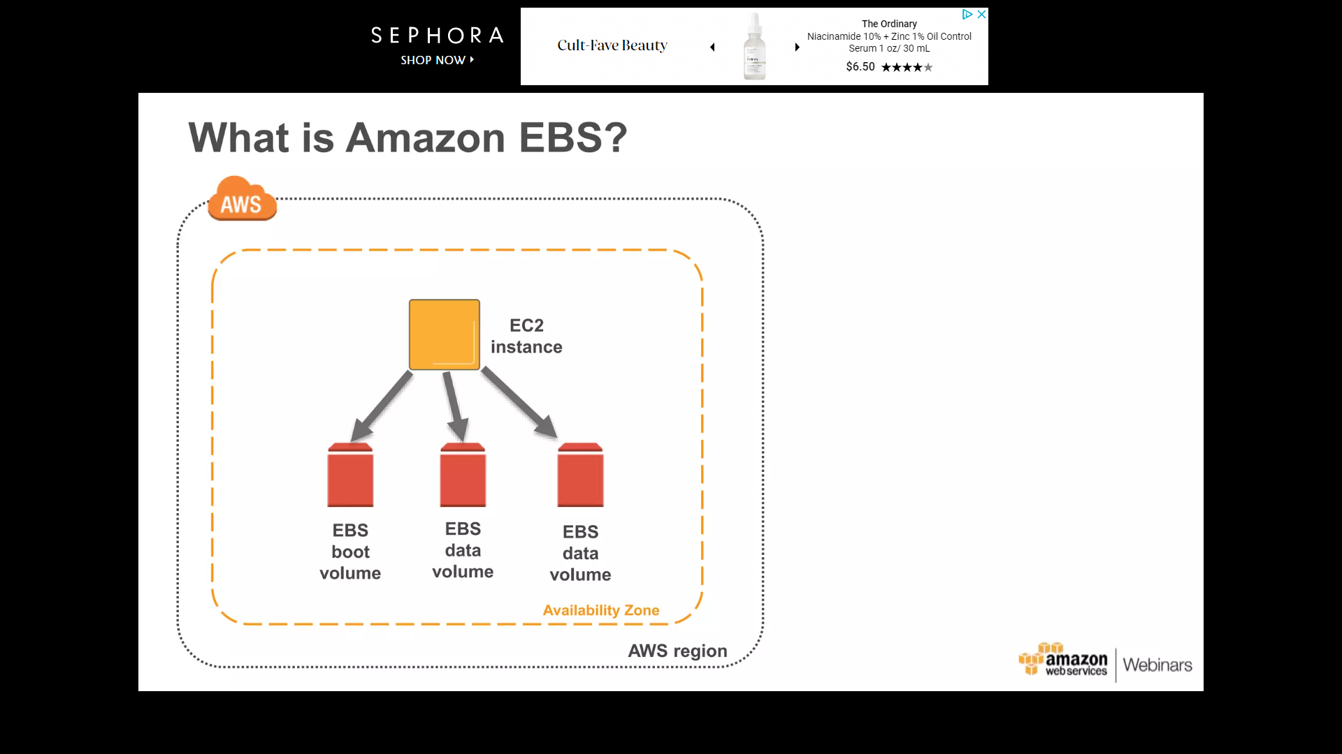
AMAZON EBS VOLUMES
An Amazon EBS volume is a durable, block-level storage device that you can attach to EC2 instance.
20X Better than off the self disk drive

Slide 3
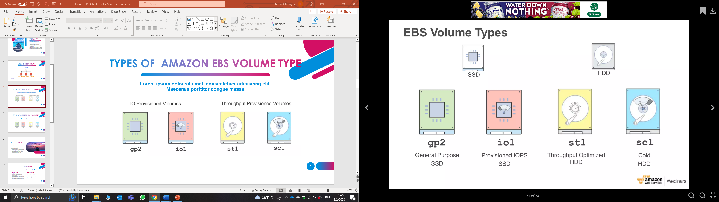
TYPES OF AMAZON EBS VOLUME

Slide 4
REQUIREMENTS OF EXPEDIA, INC.
Expedia’s website provide quick and responsive service
Minimal network latency
No occurrence of Site abandonment
High level of availability at different locations
Cost effective

Slide 5
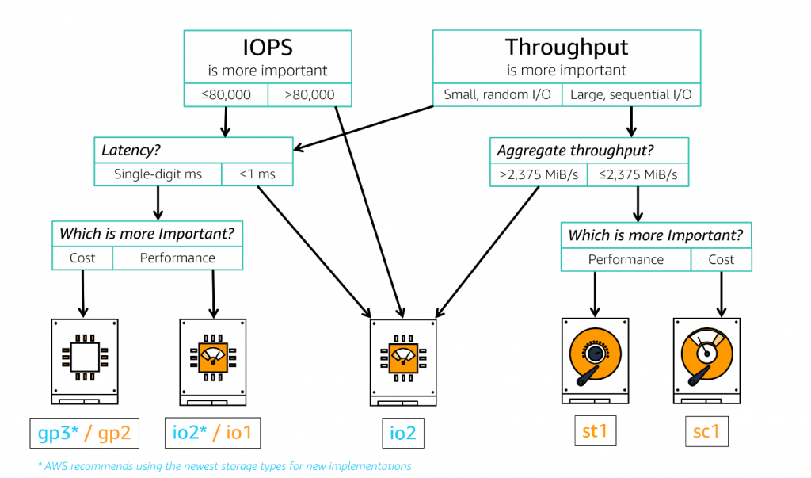
CHOOSING THE BEST SOLUTION

Slide 6
RECOMMENDATION
Provisioned IOPS SSD (io1)
Ideal volume type for I/O-intensive workloads at upmost performance
SSD-backed volumes are optimized for transactional workloads involving frequent read/write operations with small I/O size
Provisioned IOPS(SSD) can provide required level of performance for ESS.
Ensures ESS can run in locations physically close to customers
Minimal network latency at all locations

Slide 7
PERFORMANCE USING io1
Fulfilment of ESS requires to be errorless and quick data access
Volume size 4GiB – 16 TiB
Up to 64,000 IOPS per volume
99.9% durability
Up to 50 IOPS/GiB for io1.
Multi-attach support

Slide 8

COST AND POTENTIAL SAVINGS
Provisioned IOPS SSD (io1) Volumes costs $0.125 per GB-month of provisioned storage AND $0.065 per provisioned IOPS-month
Paying only what we use
Reducing cost with Elasticity
Avoiding overprovision
Uncompromised ESS performance without expensive hardware

Slide 9

SECURITY CONSIDERATIONS
Encryption using AWS Key Management Service (KMS)
Creating EBS Snapshots of all volumes
Access control using Amazon IAM
Monitoring using AWS CloudTrail
Topmost Disaster recovery
Compliance with variety of regulations

Slide 10



BENEFITS OF CLOUD-BASED SOLUTION ARCHITECTURES VS ON-PREMISES
Scalability
Cost Savings
Flexibility and Accessibility
Security
Reliability
Innovation

Slide 11

CONCLUSION
io1 Amazon EBS SSD volume type have required performance characteristics
Cost optimization can be achieved using various techniques
ESS will perform smoothly and lower latency transactions
Security measures implementation assuring data privacy
Benefits of Cloud solutions over On premises

Slide 12

REFERENCES
https://docs.aws.amazon.com/AWSEC2/latest/UserGuide/ebs-volume-types.html#vol-type-ssd
https://docs.aws.amazon.com/emr/latest/ManagementGuide/emr-plan-storage.html
https://aws.amazon.com/ebs/pricing/Monitoring using AWS CloudTrail
https://digitalcloud.training/amazon-ebs/

Slide 13

THANK YOU!
Ketan Kshirsagar
Technical Consultant,
Expedia, Inc.

